Slide 1
Session 02
Network Model
Subject : Z1451 / Jaringan Komputer Year : 2015

Slide 2
References
Main Reference Session 02: Forouzan, B.A., (2010). TCP/IP Protocol Suite, 4th Edition, Mc.Graw-Hill Chapter 2.1; 2.2; 2.3

Slide 3
Outline
Layering model
Model OSI 7 layer
Model TCP/IP

Slide 4
LAYERING MODEL
2-1 PROTOCOL LAYERS
In Chapter 1, we discussed that a protocol is required when two entities need to communicate. When communication is not simple, we may divide the complex task of communication into several layers. In this case, we may need several protocols, one for each layer.
Let us use a scenario in communication in which the role of protocol layering may be better understood. We use two examples. In the first example, communication is so simple that it can occur in only one layer.
Forouzan, B.A., (2010). TCP/IP Protocol Suite, 4th Edition, Mc.Graw-Hill

Slide 5
LAYERING MODEL
Example 2.1
Assume Maria and Ann are neighbors with a lot of common ideas. However, Maria speaks only Spanish, and Ann speaks only English. Since both have learned the sign language in their childhood, they enjoy meeting in a cafe a couple of days per week and exchange their ideas using signs. Occasionally, they also use a bilingual dictionary. Communication is face to face and Happens in one layer as shown in Figure 2.1.
Forouzan, B.A., (2010). TCP/IP Protocol Suite, 4th Edition, Mc.Graw-Hill

Slide 6
LAYERING MODEL
Figure 2.1 Example 2.1
Forouzan, B.A., (2010). TCP/IP Protocol Suite, 4th Edition, Mc.Graw-Hill

Slide 7
LAYERING MODEL
Example 2.2
Now assume that Ann has to move to another town because of her job. Before she moves, the two meet for the last time in the same cafe. Although both are sad, Maria surprises Ann when she opens a packet that contains two small machines. The first machine can scan and transform a letter in English to a secret code or vice versa. The other machine can scan and translate a letter in Spanish to the same secret code or vice versa. Ann takes the first machine; Maria keeps the second one. The two friends can still communicate using the secret code, as shown in Figure 2.2.
Forouzan, B.A., (2010). TCP/IP Protocol Suite, 4th Edition, Mc.Graw-Hill

Slide 8
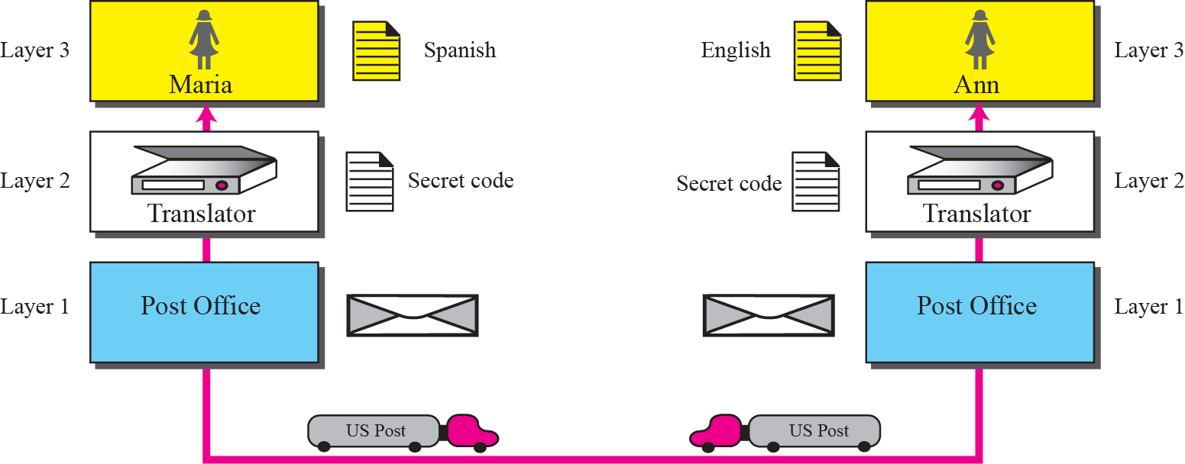
LAYERING MODEL
Figure 2.2 Example 2.2
Forouzan, B.A., (2010). TCP/IP Protocol Suite, 4th Edition, Mc.Graw-Hill

Slide 9
MODEL OSI 7 LAYER
2-2 THE OSI MODEL
Established in 1947, the International Standards Organization (ISO) is a multinational body dedicated to worldwide agreement on international standards. Almost three-fourths of countries in the world are represented in the ISO. An ISO standard that covers all aspects of network communications is the Open Systems Interconnection (OSI) model. It was first introduced in the late 1970s.
Forouzan, B.A., (2010). TCP/IP Protocol Suite, 4th Edition, Mc.Graw-Hill

Slide 10

MODEL OSI 7 LAYER
Note
ISO is the organization;
OSI is the model.
Forouzan, B.A., (2010). TCP/IP Protocol Suite, 4th Edition, Mc.Graw-Hill

Slide 11
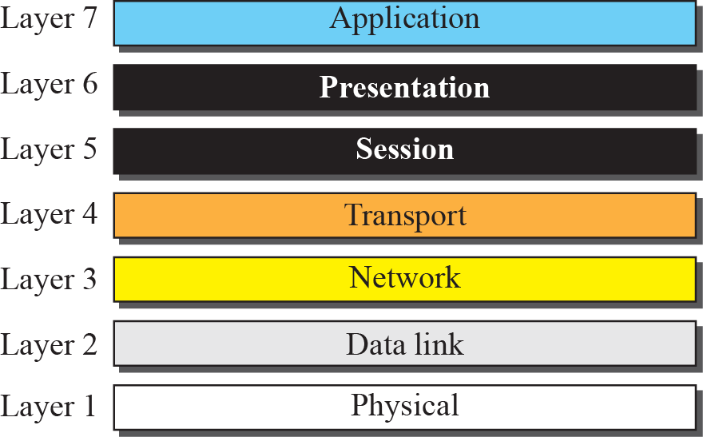
MODEL OSI 7 LAYER
Figure 2.3 The OSI model
Forouzan, B.A., (2010). TCP/IP Protocol Suite, 4th Edition, Mc.Graw-Hill

Slide 12
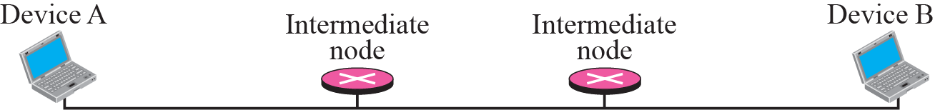
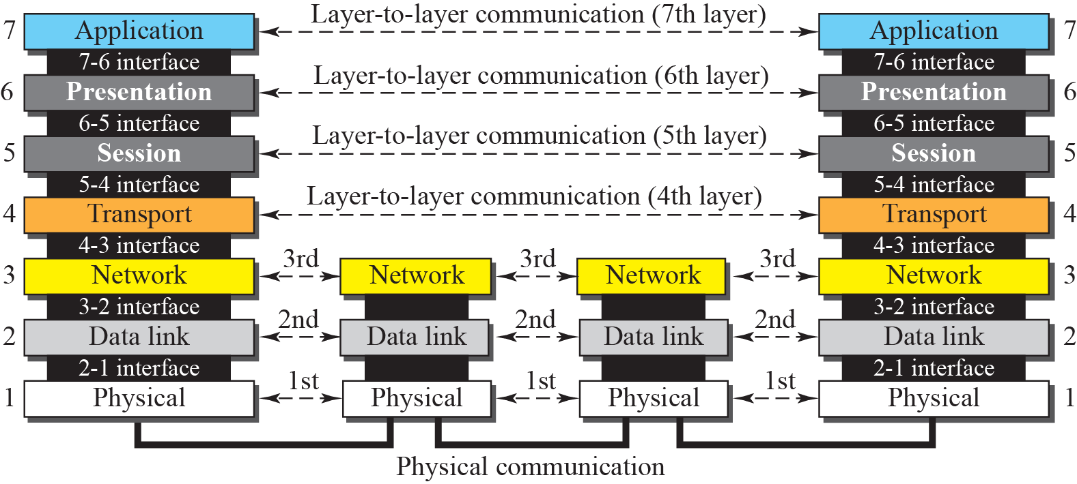
MODEL OSI 7 LAYER
Figure 2.4 OSI layers
Forouzan, B.A., (2010). TCP/IP Protocol Suite, 4th Edition, Mc.Graw-Hill

Slide 13
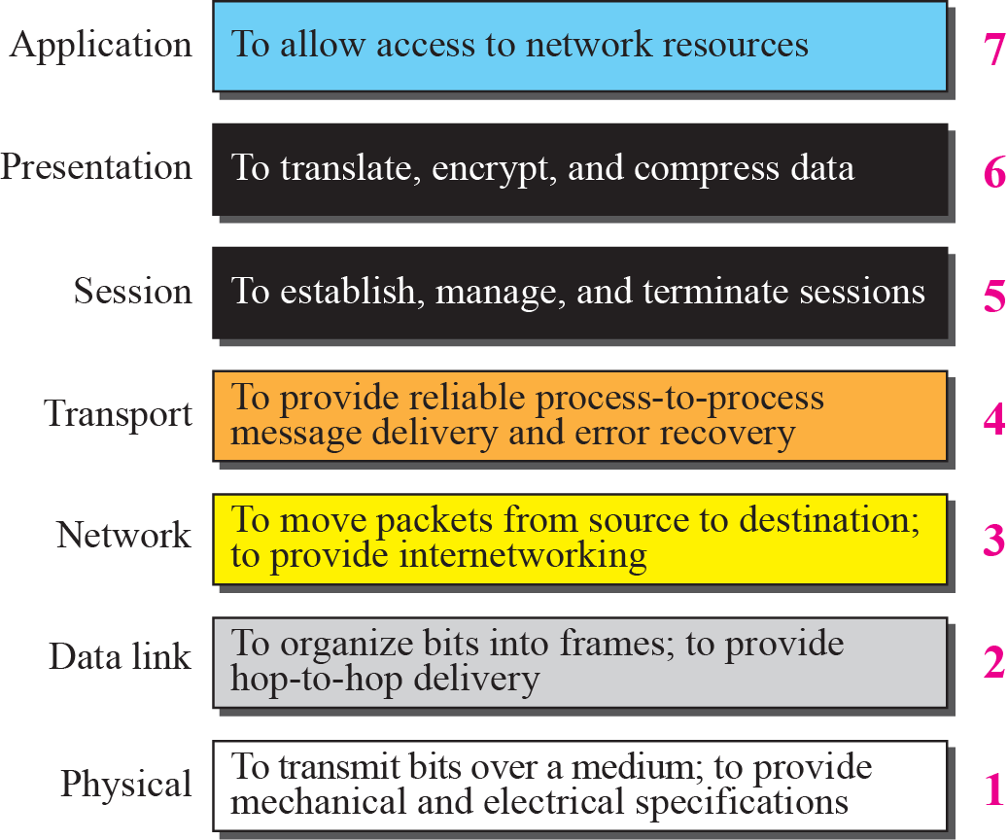
MODEL OSI 7 LAYER
Forouzan, B.A., (2010). TCP/IP Protocol Suite, 4th Edition, Mc.Graw-Hill

Slide 14
NETWORK MODEL
2-3 TCP/IP PROTOCOL SUITE
The TCP/IP protocol suite was developed prior to the OSI model. Therefore, the layers in the TCP/IP protocol suite do not match exactly with those in the OSI model. The original TCP/IP protocol suite was defined as four software layers built upon the hardware. Today, however, TCP/IP is thought of as a five-layer model with the layers named similarly to the ones in the OSI model. Figure 2.7 shows both configurations.
Forouzan, B.A., (2010). TCP/IP Protocol Suite, 4th Edition, Mc.Graw-Hill

Slide 15
MODEL OSI & TCP/IP LAYER
Comparison between OSI and TCP/IP
Layers in the TCP/IP Suite
Forouzan, B.A., (2010). TCP/IP Protocol Suite, 4th Edition, Mc.Graw-Hill

Slide 16
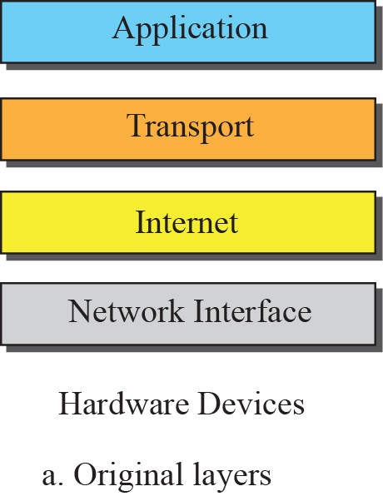
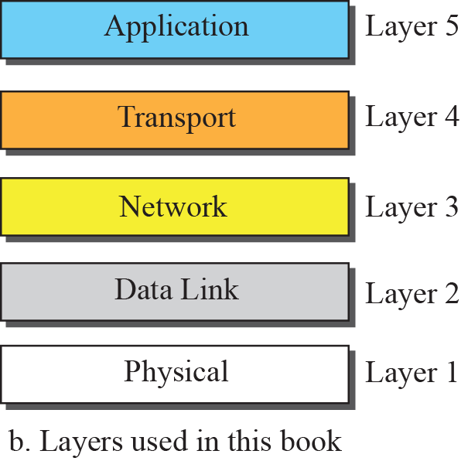

MODEL OSI & TCP/IP LAYER
Figure 2.7 Layers in the TCP/IP Protocol Suite

Slide 17
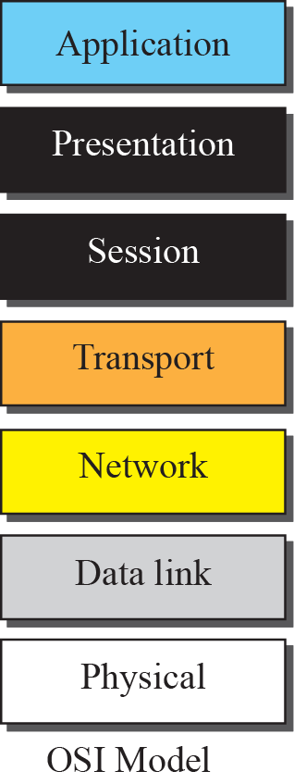
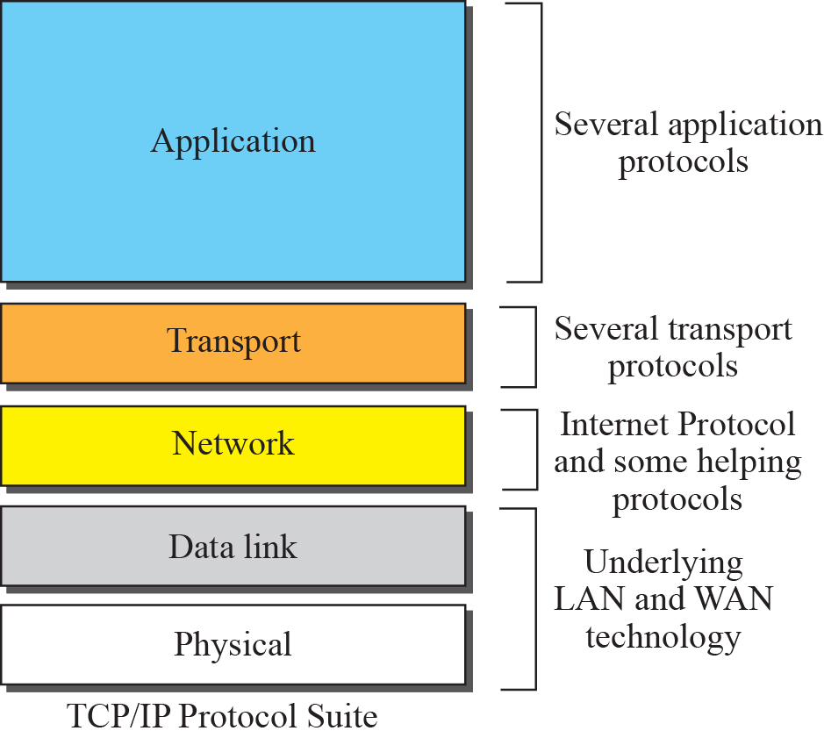
MODEL OSI & TCP/IP LAYER
Figure 2.8 TCP/IP and OSI model
Forouzan, B.A., (2010). TCP/IP Protocol Suite, 4th Edition, Mc.Graw-Hill

